Slide 1
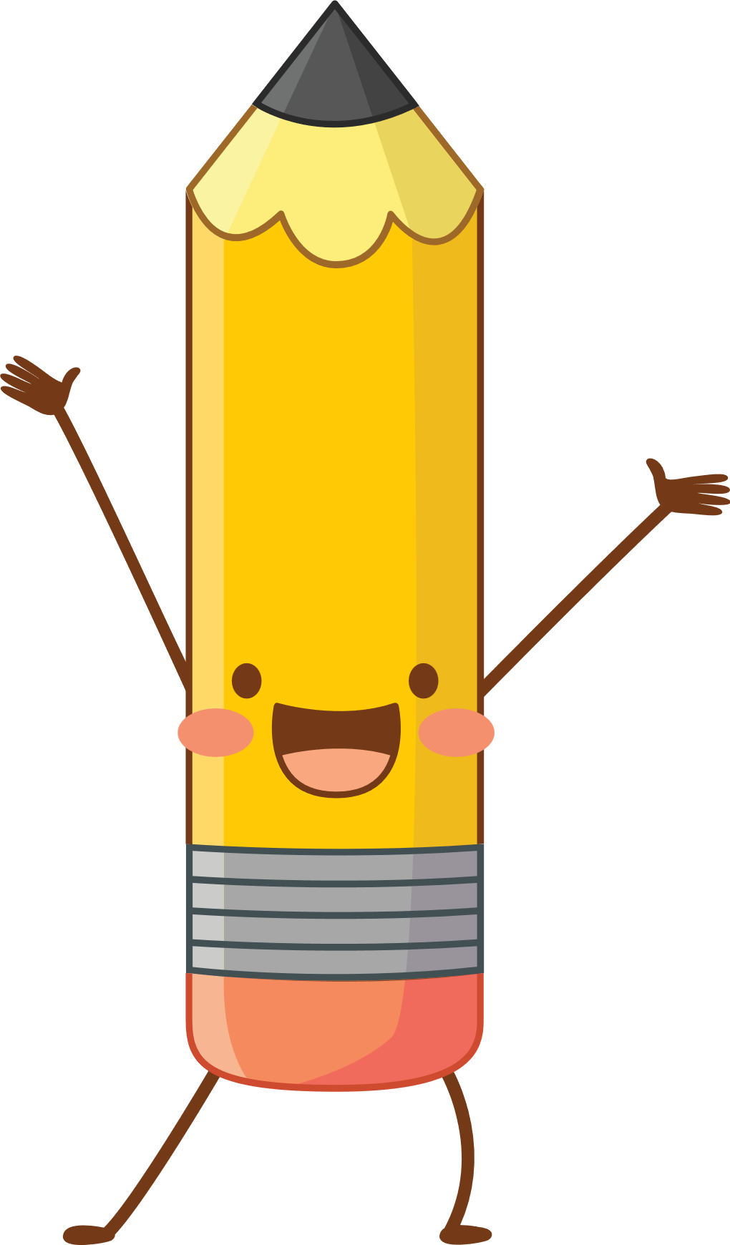


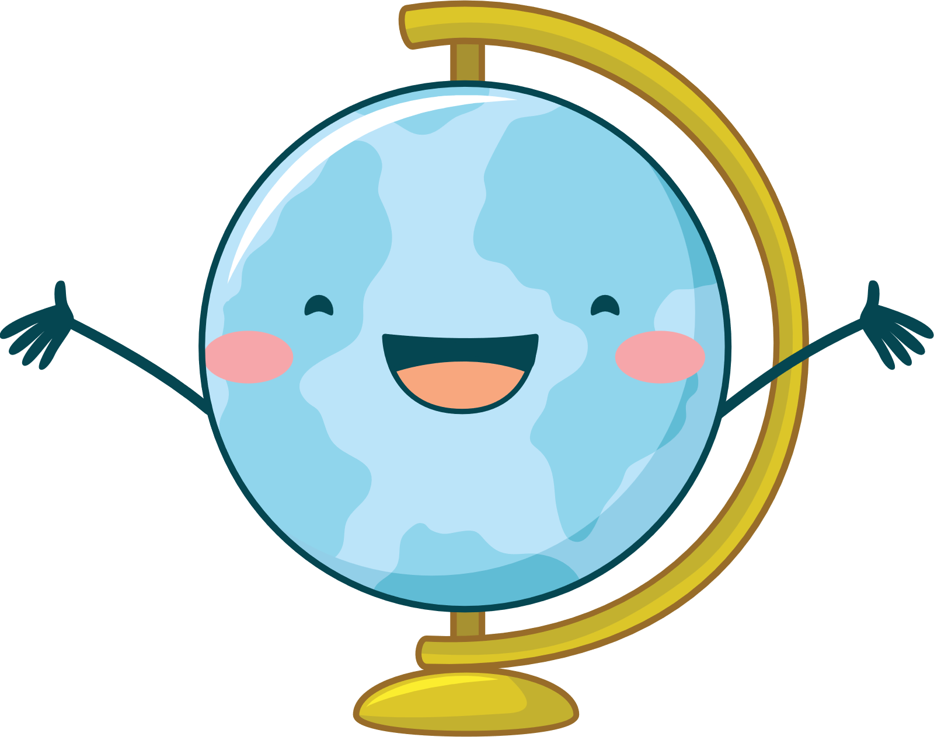
Domestic Electric Circuits

Slide 2
Welcome Parents!
Welcome parents to your classroom.
List the goals for the open house:
To help parents understand the work their child will be doing throughout the school year.
To explain your expectations of their child.
To share information about how parents can support their child’s learning.

Slide 3
Curriculum Goals
Describe what the students will study during the school year, including the overall curriculum plans and goals.
Include a detailed, colorful syllabus for parents to take home.
Suggest ways that parents can help their child learn, such as reading together for 20 minutes a day.
Use more than one slide to cover this information.

Slide 4
Class Information
Explain how students will be evaluated and graded.
Tell parents when report cards and progress reports will be sent home.
Describe the amount of homework students can expect.
Provide a calendar of upcoming events, such as class field trips and parent-teacher conferences

Slide 5
Main Board
It is provided outside the building under a covered place. It contains the energy-meter and the main switch.
From the street electrical pole. A thick rubber insulated cord reaches the main board. It contains two thick copper or aluminum wires, once covered with red and other covered with black plastic covering. They Form:
The line wire (L) – Potential 220 V
Neutral line wire (N) – Potential 0 V
A third wire is a thick bare wire of copper, called earth wire E.
It is connected to an earth connection which consists of a thick copper plate P buried deep inside the moist earth.

Slide 6
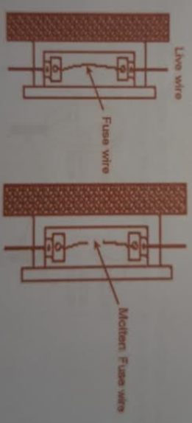
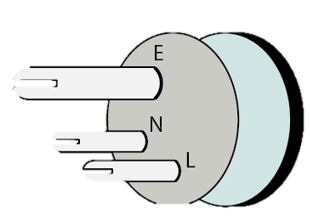
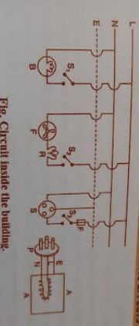
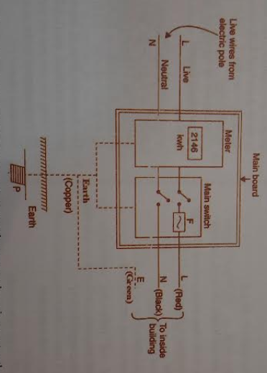
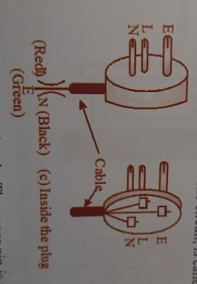
Earthing
Connecting the metallic body of a high powered electrical appliance to the earth wire of domestic circuit.
Due to wear and tear with long use, live wire touches the body of application. When we operate this with our bare hands, it will cause a severe shock.
If a application is earthed, its body potential remains zero due to contact with the earth. Nothing is felt when such an application is operated.

Slide 7
Over-loading & Short-circuiting
Overloading: when high powered electric appliance like refrigerator, AC electric iron are witched on simultaneously, total current through main wire may exceed the tolerance limit causing damage and fire.
Short Circuiting: Due to long use wear and tear or defective insulating material, the live and the neutral wires may become bare at some points and come in direct contact. Due to zero resistance, a large current is produced and a huge sparkling is caused at point of contact. It may cause damages and fire.

Slide 8

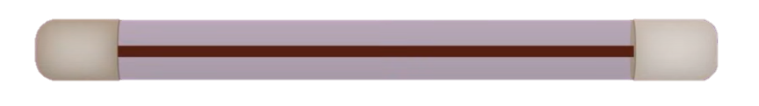
Electric Fuse
Safety device used to avoid fire due to over loading/short circuiting
Consists of thin wire pf pure tin or alloy of copper and tin
Fuse wire is a high resistant wire having low melting point.

Slide 9
Miniature Circuit Breaker
Automatic switch that opens when excessive current flows through circuit
Better than a fuse for the following reasons:
Fuse must be replaced after it has been operated, but not in the case of MCB.
Whenever there is a fault in a circuit the MCB switches off immediately, this way it is faster than fuse.
Can be reset quickly compared to a fuse.

